Slide 1
musIV
Music By IVjot
Submitted By - Ivjot Singh
CSE-2 08213202714

Slide 2

Ms. Meenakshi
Ms. Jasleen kaur Sethi
SUBMITTED TO

Slide 3
Table of Contents
Introduction
Fundamentals
Premium Features
3 Unique elements
Project Portfolio
Screenshots of the Project
Maintenance
Admin Panel
On Page SEO
Digital Marketing and Google Standards
Thank you

Slide 4


INTRODUCTION

Slide 5
MUSIV
Music by Ivjot
A Music Website
Musiv is a fully-responsive and dynamic music website based on MVT(Model View Template) architecture and Google algorithm which provides smooth and free way to listen all of your favourite music of Genre:
Punjabi
English
Bollywood
Workout
EDM
Devotional

Slide 6
Premium features
.

Slide 7




Smart Search
Persnolised
Admin-Panel
The Smartest Search gives the fastest results along with functional user-interface as a user can access any song by entering song_name, artist_name or even the year
Listeners rate songs, resulting in a personalized favourite list of songs.
The Data can be viewed and altered in the admin panel which automatically make all the changes in the database.

Slide 8

Technology Used
Programing language:
Python
Backend:
Django
Data-base:
SQlite
Python is used because of its Dynamic nature and a fantastic Web-Framework Django which is used in the backend because of its MVT(Model View Template) architecture and SQlite is chosen because it is the by default Data-Base of Django and the Project is to be used within the machine using a Local Host embedded to the machine.

Slide 9
Project Portfolio

Slide 10
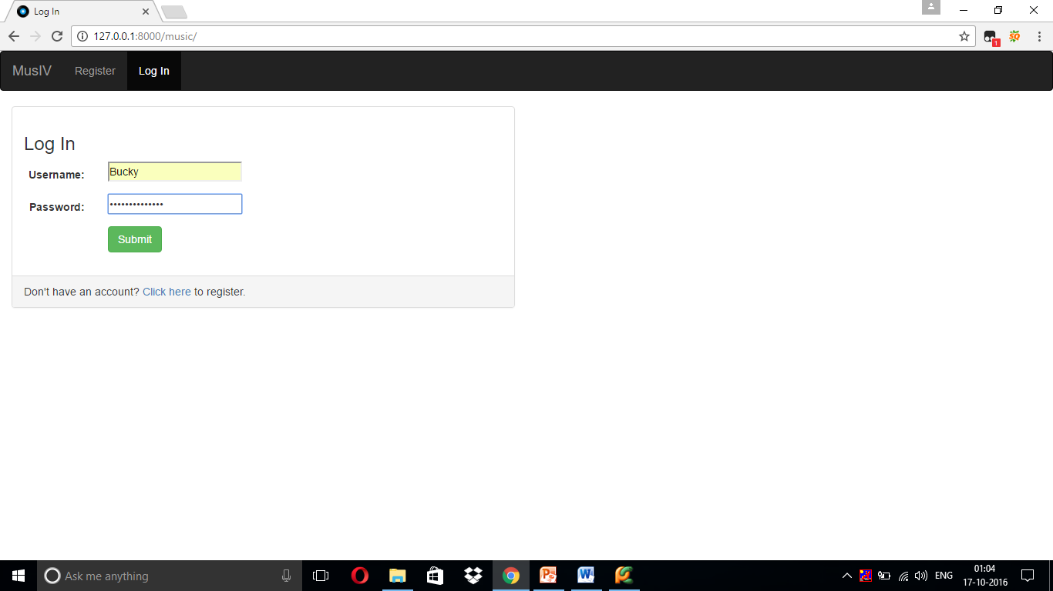
Login_page

Slide 12
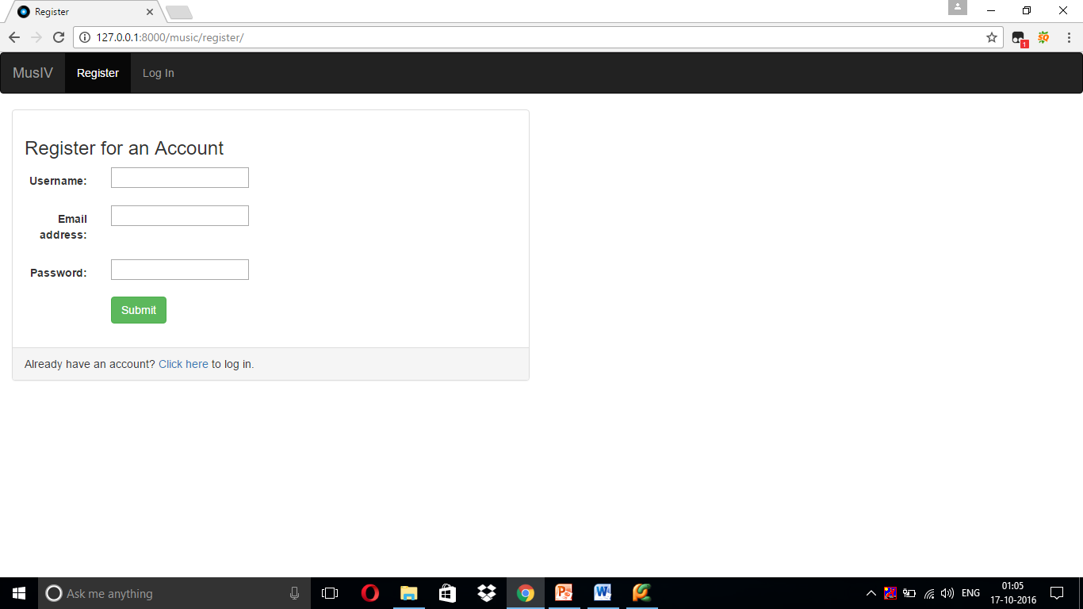

Slide 13
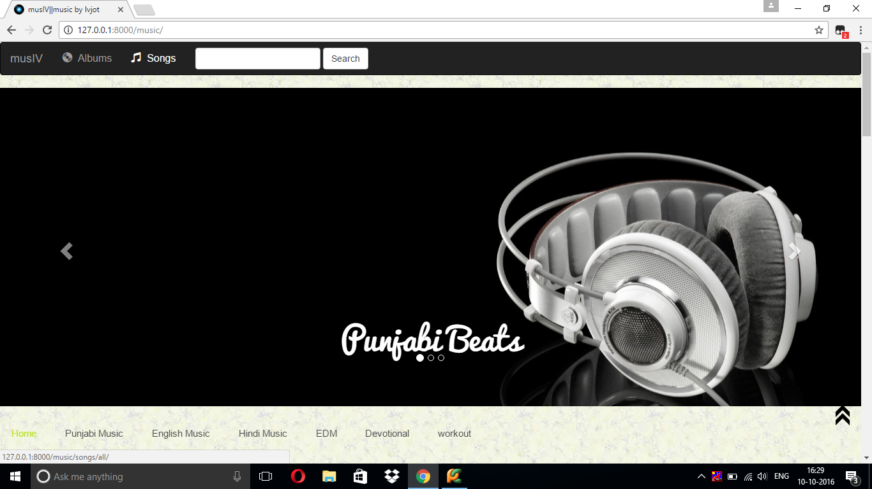
Homepage

Slide 15
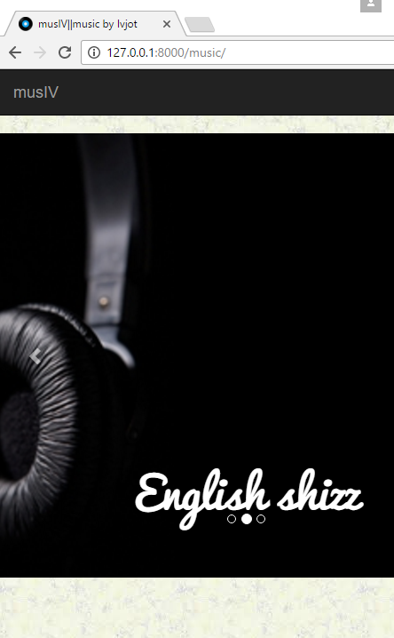
Fully Responsive
View Of Website is not effected by the screen size ( auto adjustable) as the navigator shrinks into the menu.

Slide 16
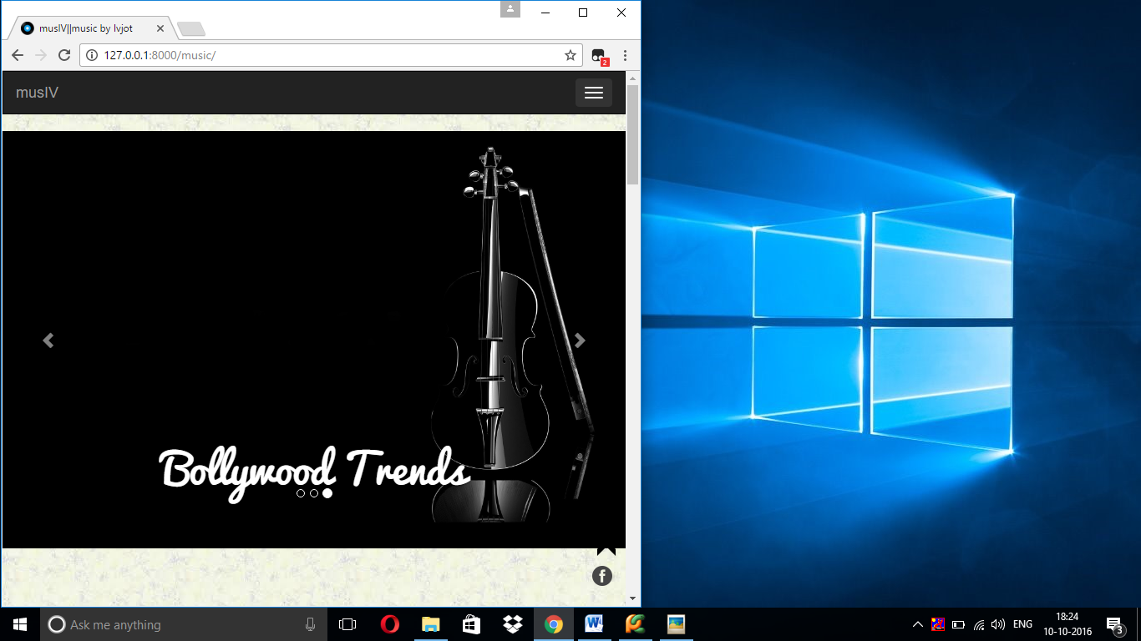

Slide 17
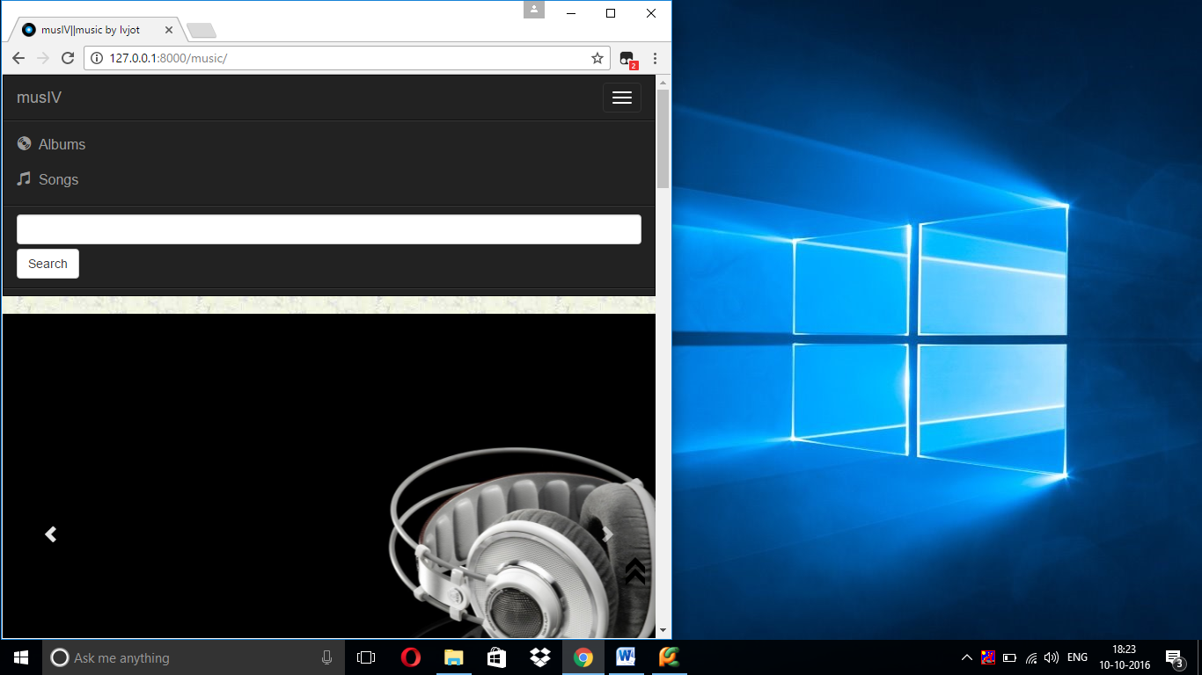

Slide 19
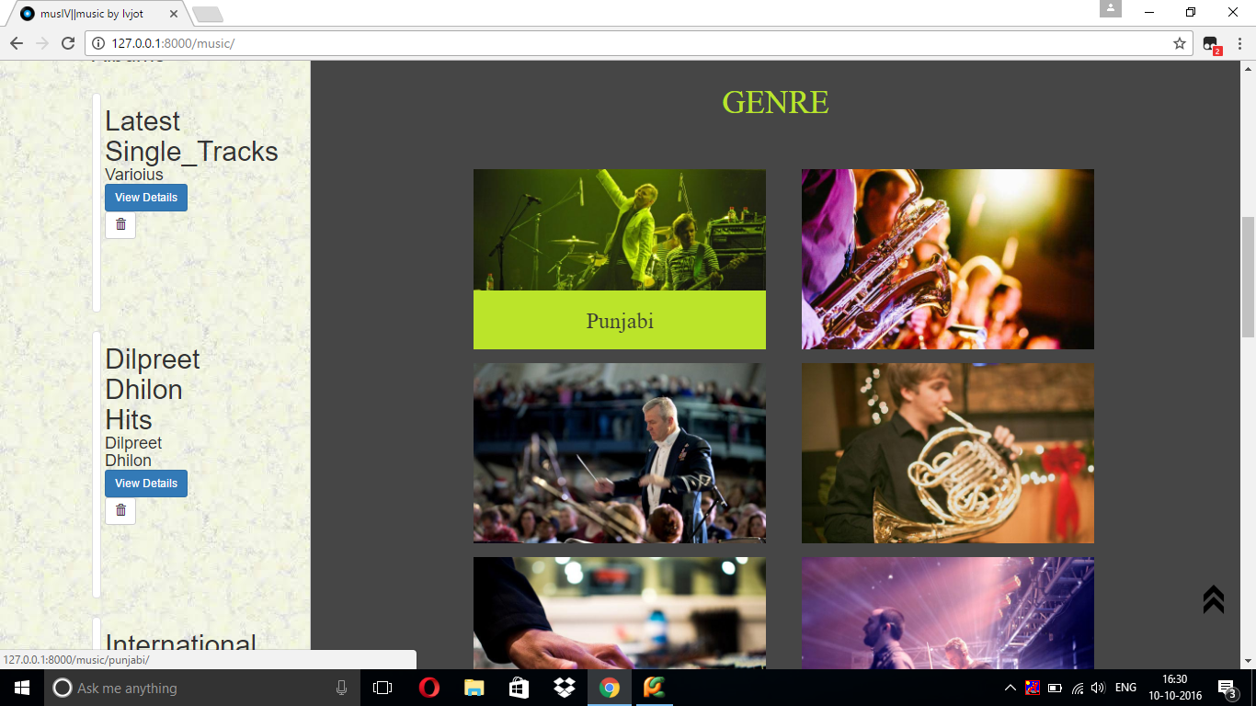

Slide 20
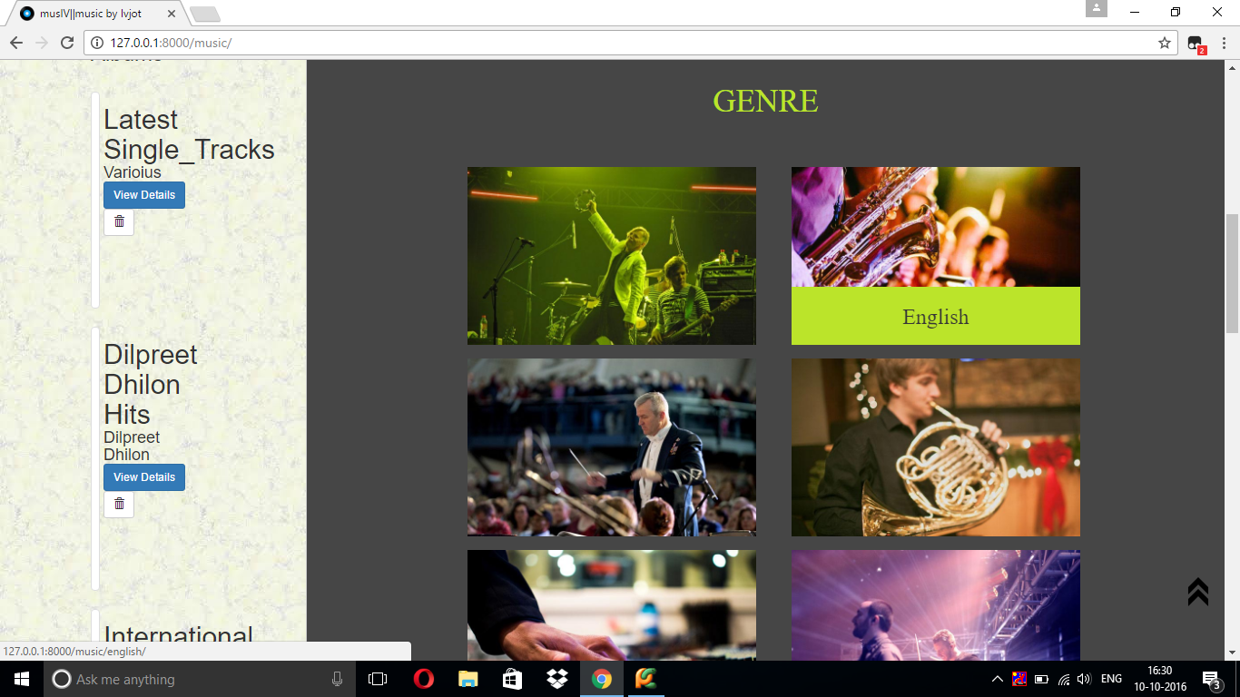

Slide 21
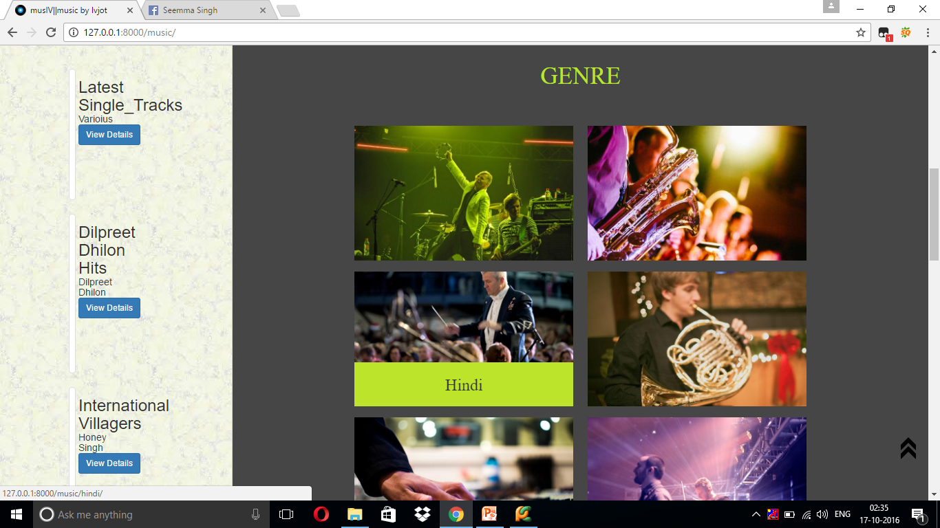

Slide 22
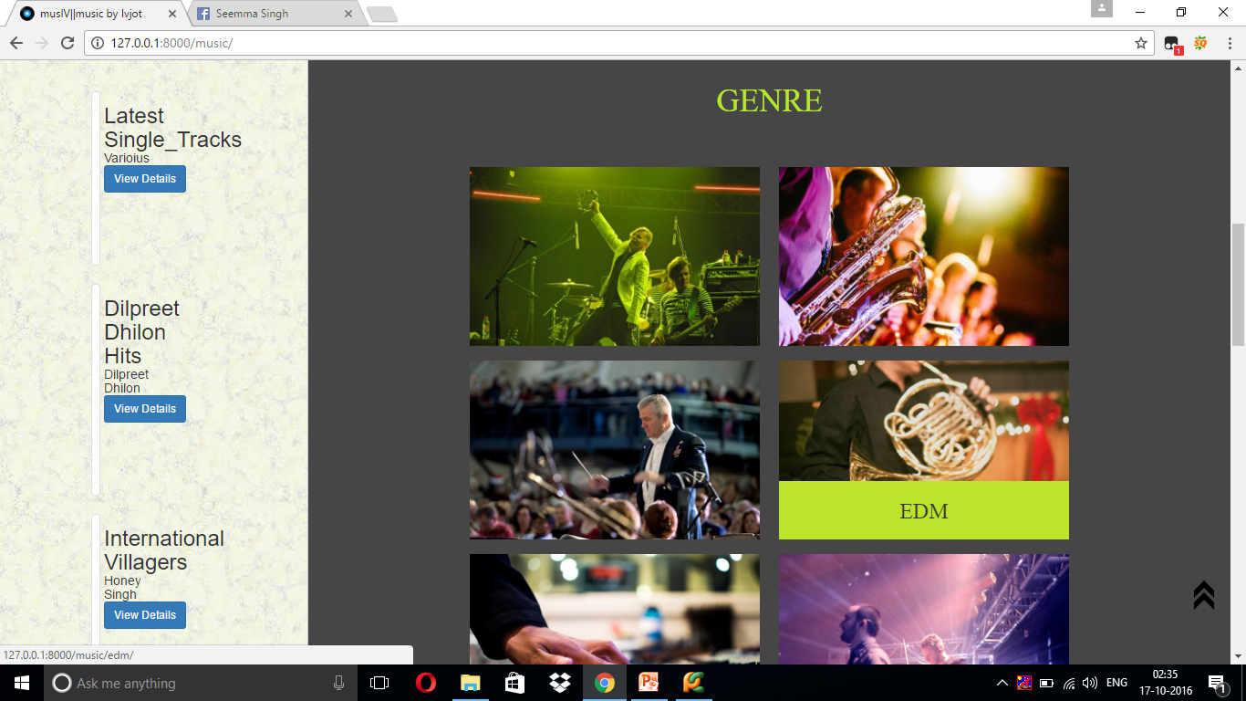

Slide 23
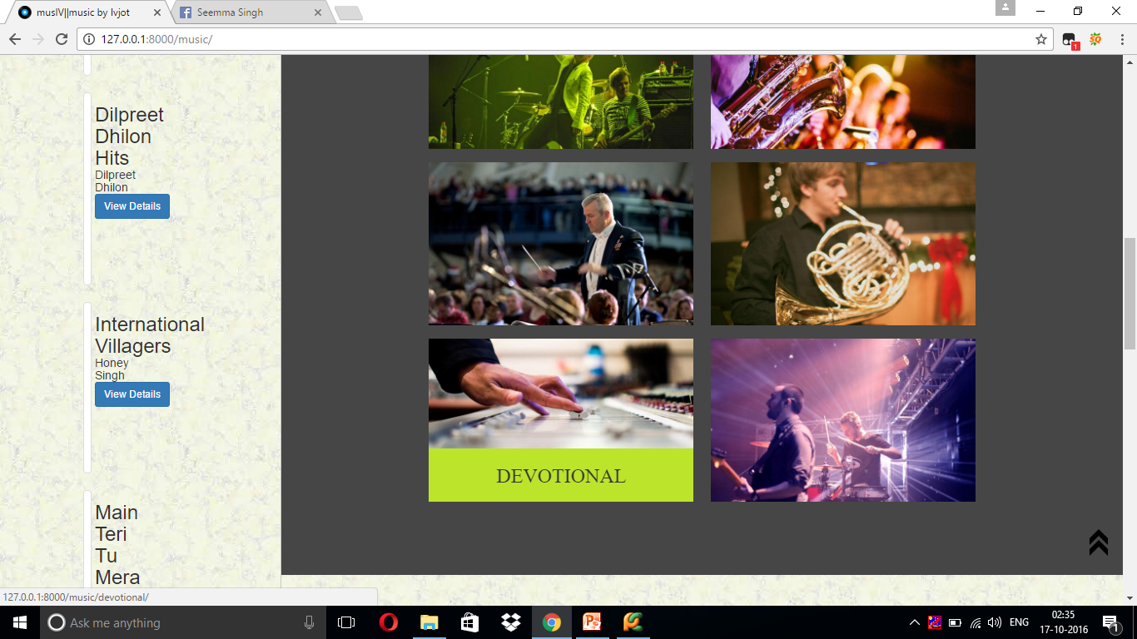

Slide 24
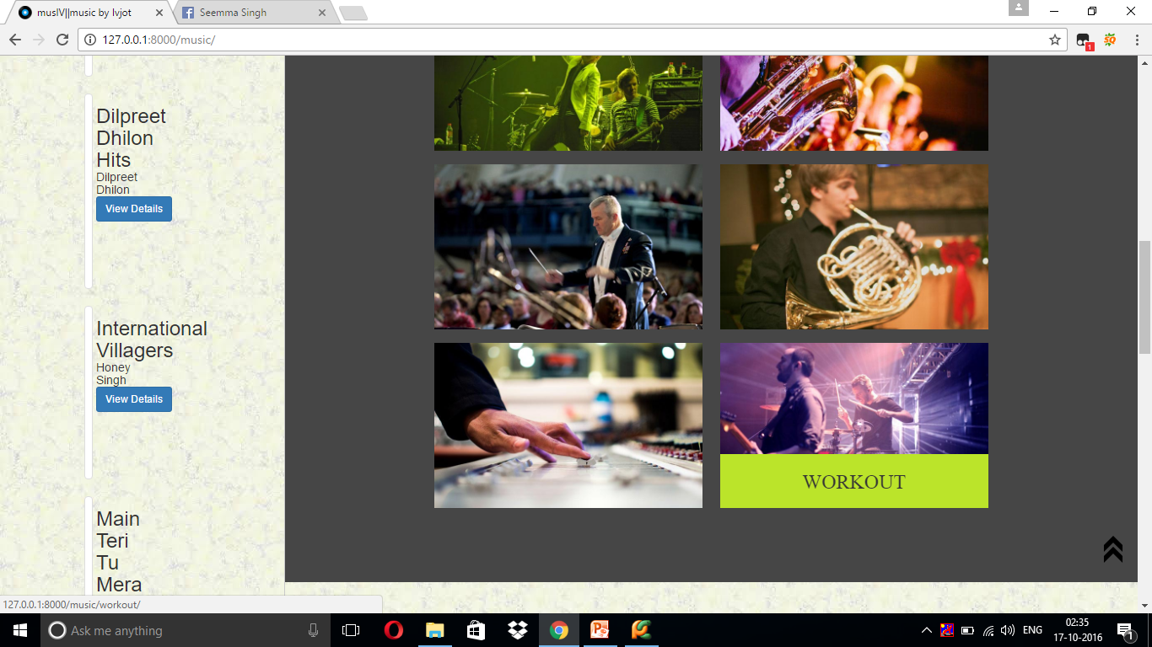

Slide 25
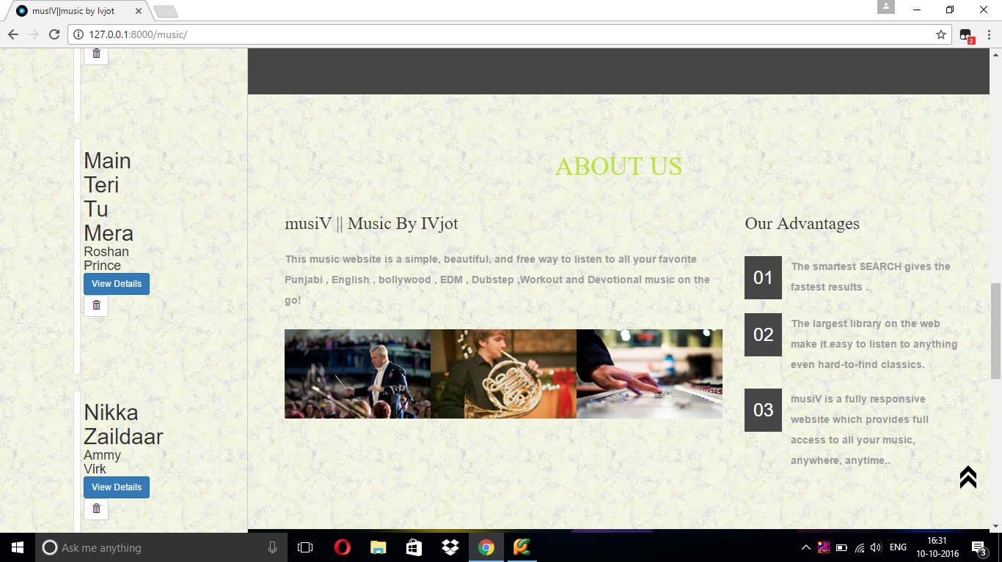

Slide 26
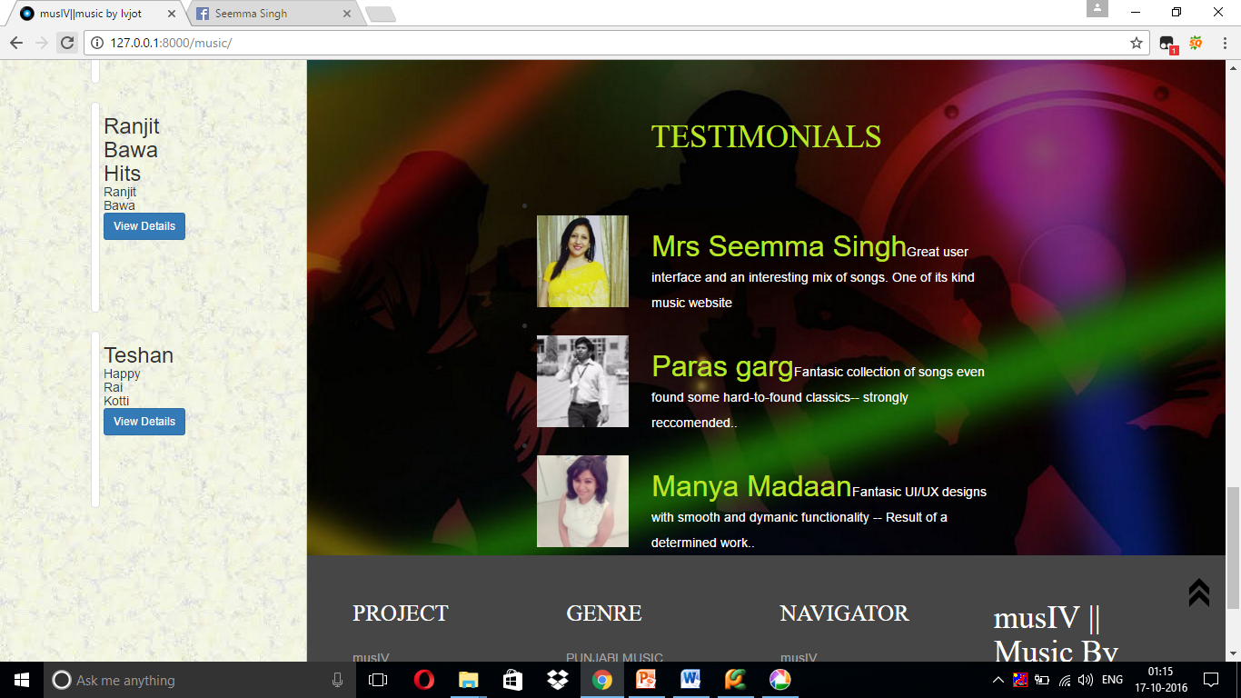

Slide 27
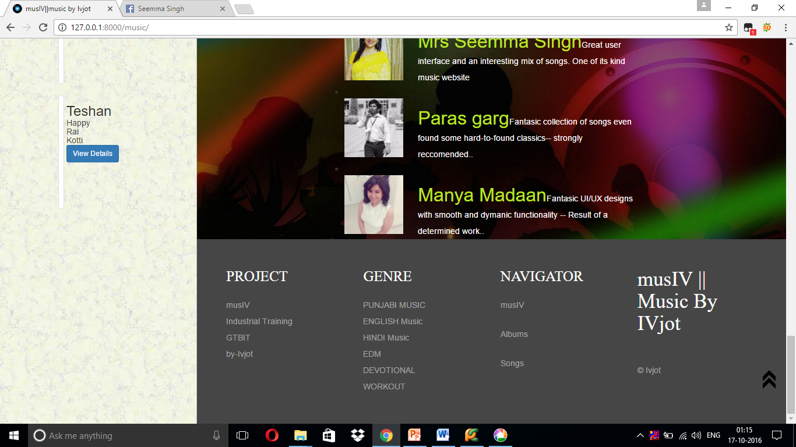

Slide 28
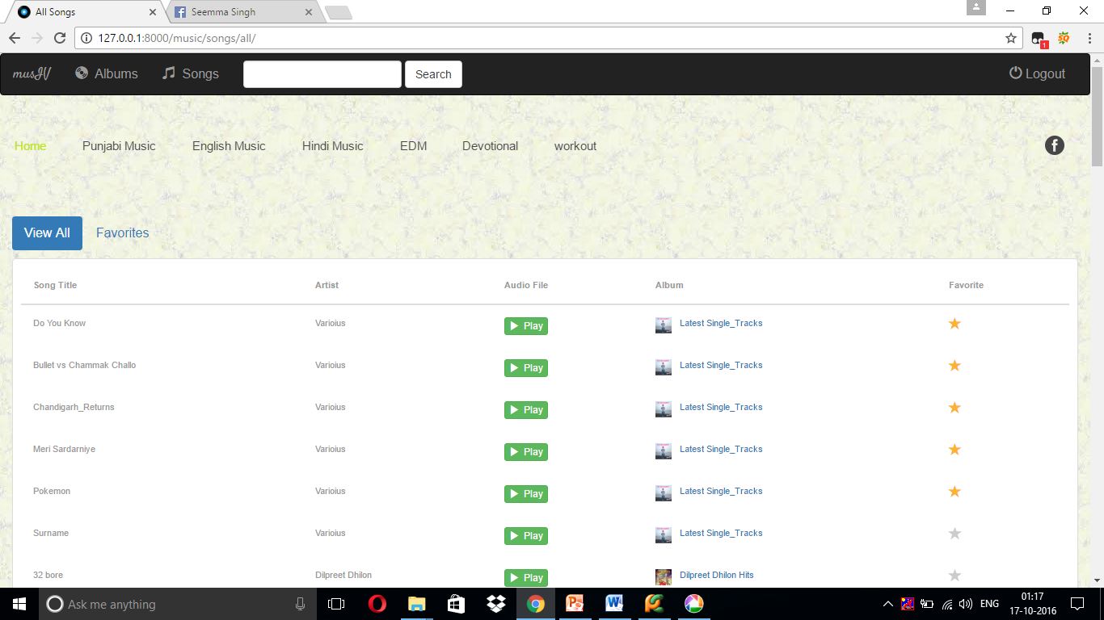
Personalised

Slide 30
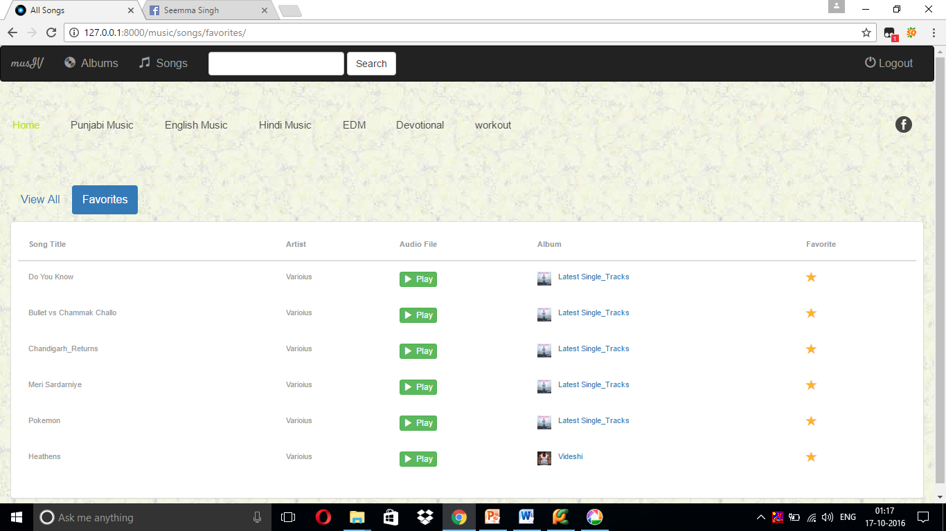

Slide 31
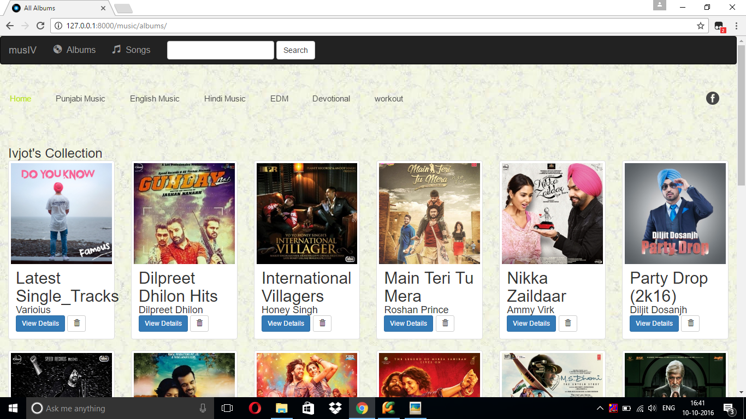

Slide 32
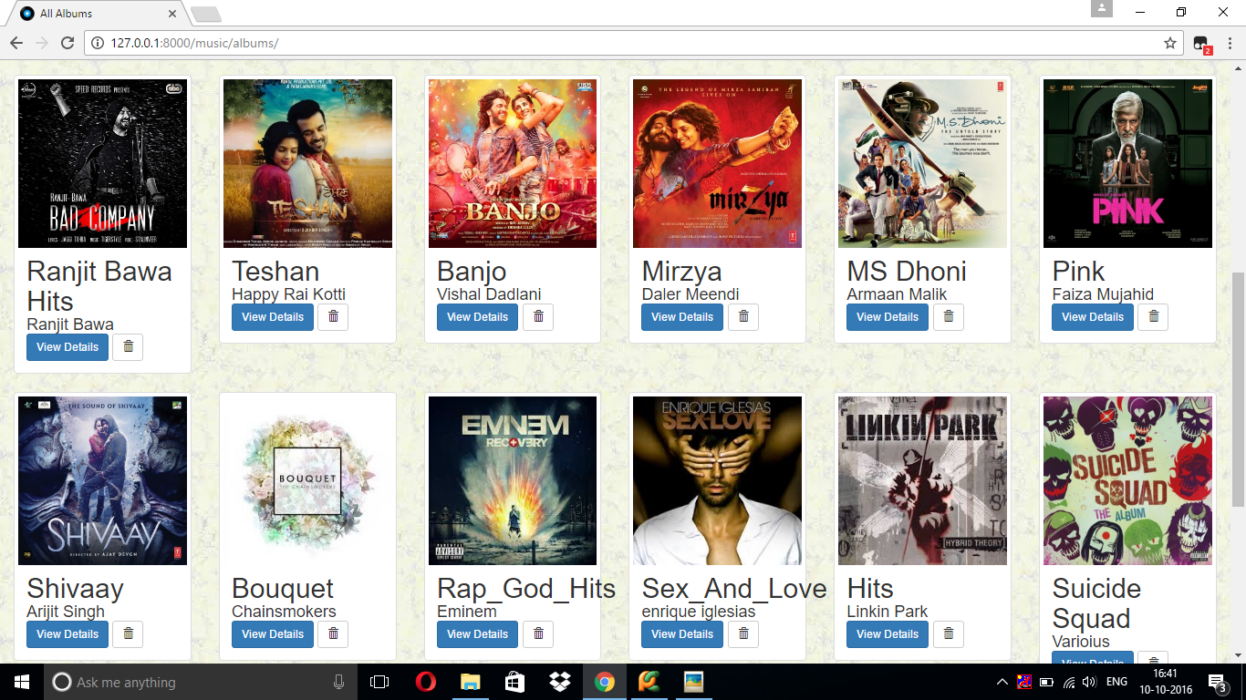

Slide 33
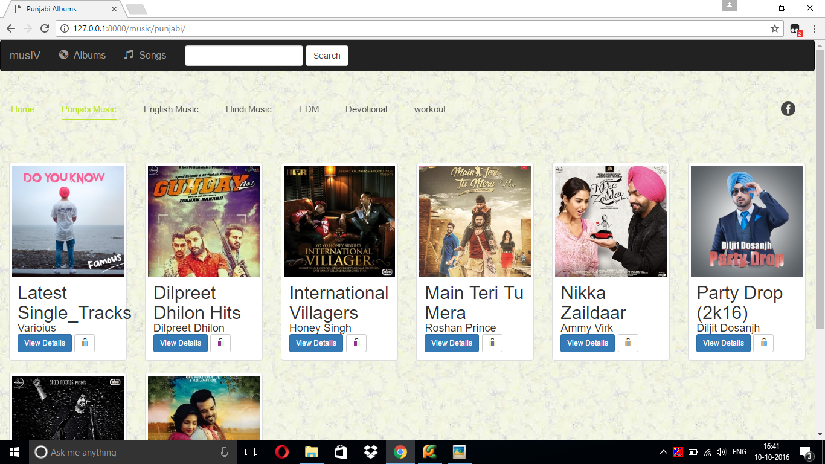
Categorised

Slide 35
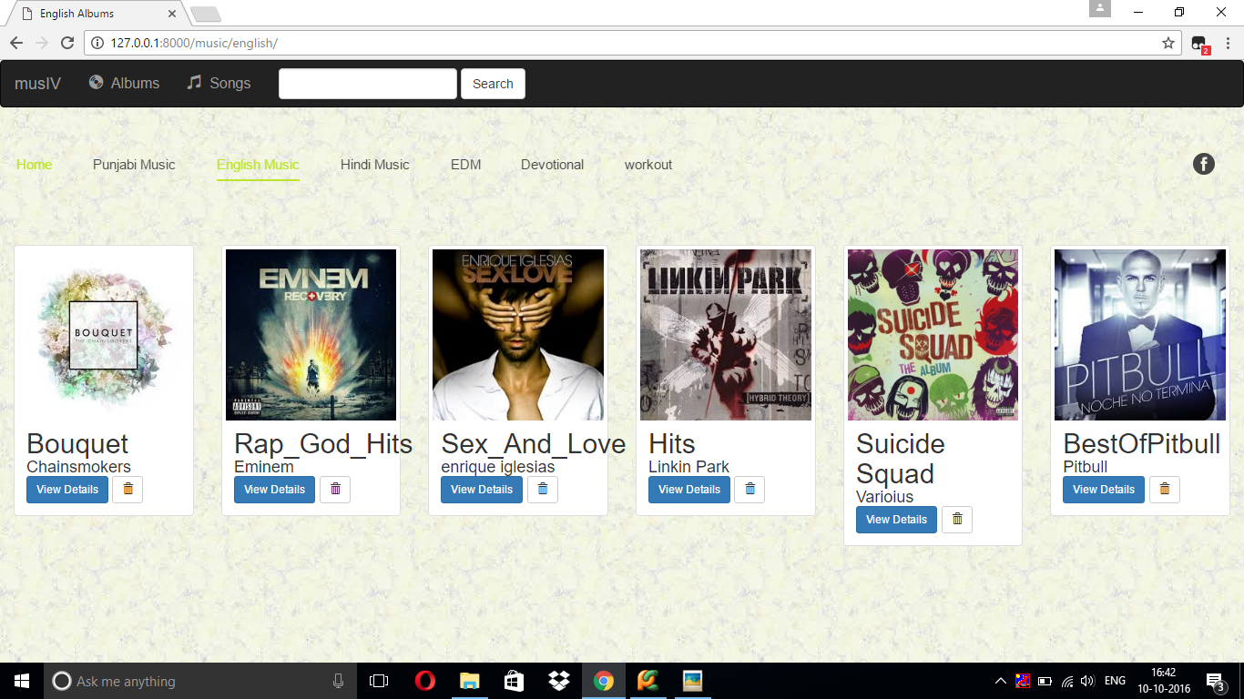

Slide 36
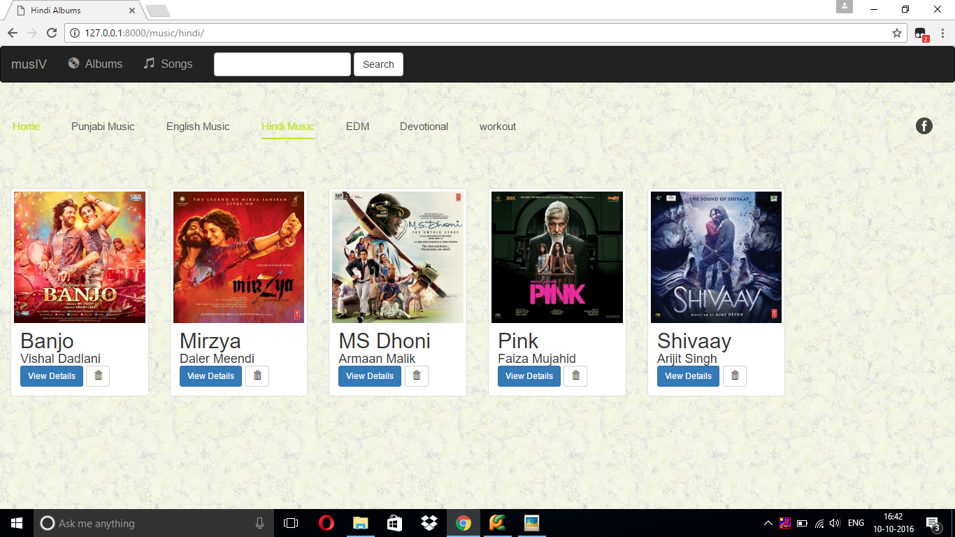

Slide 37
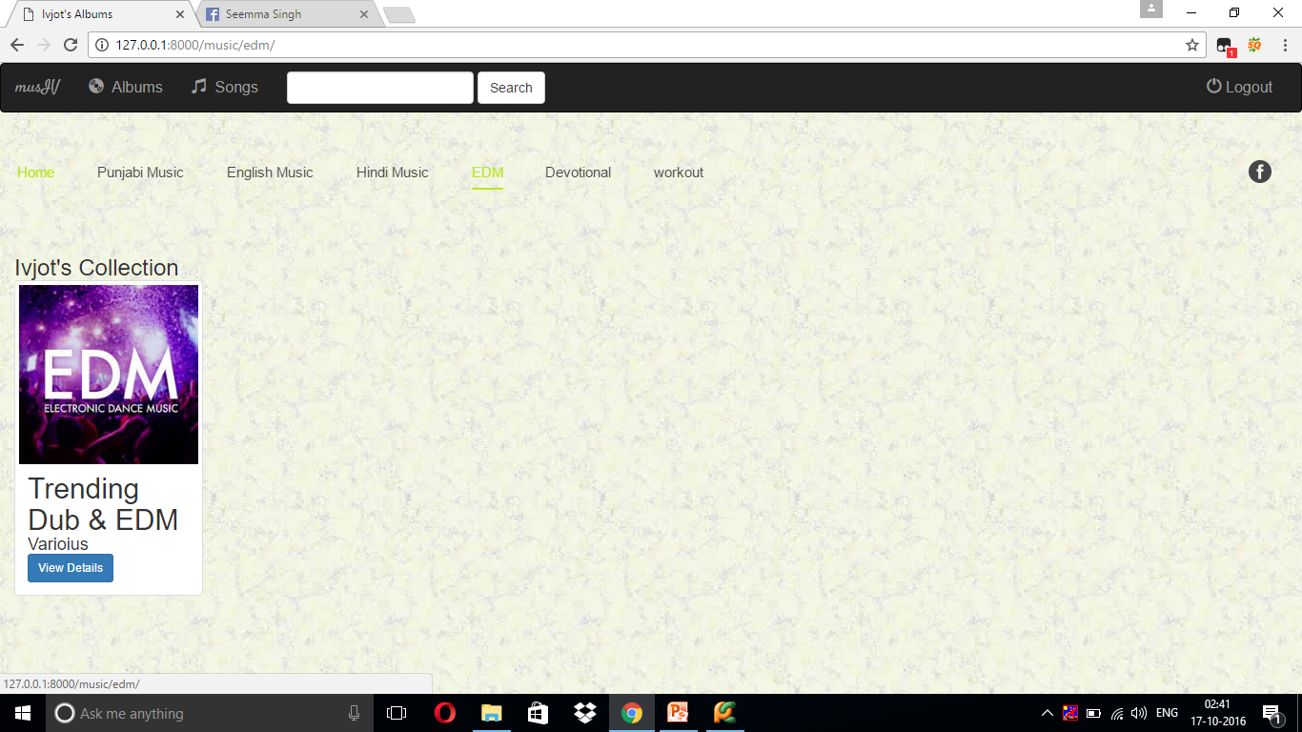

Slide 38
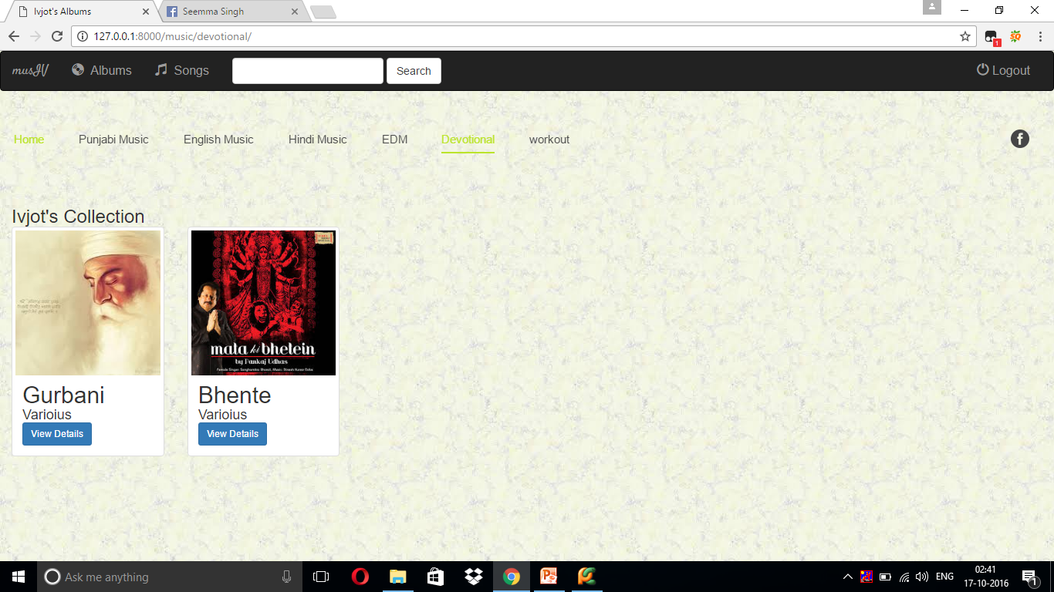

Slide 39
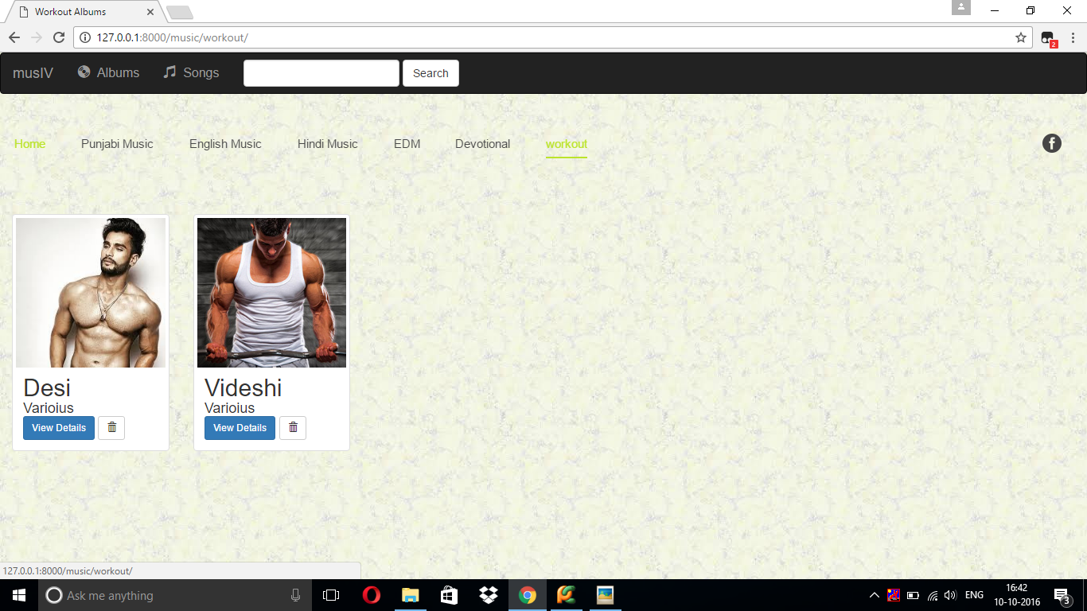

Slide 40
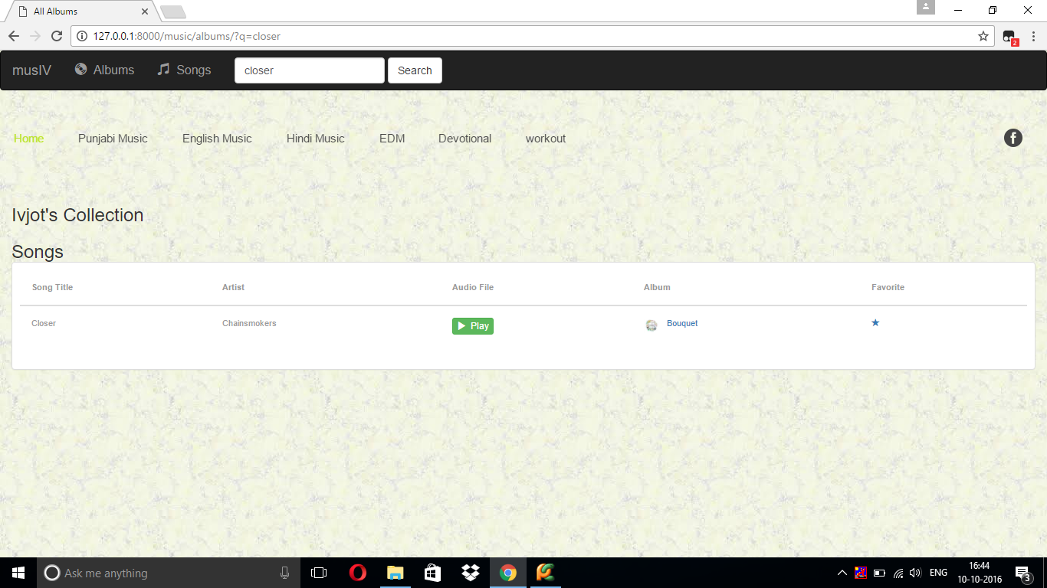
Smart Search Bar

Slide 42
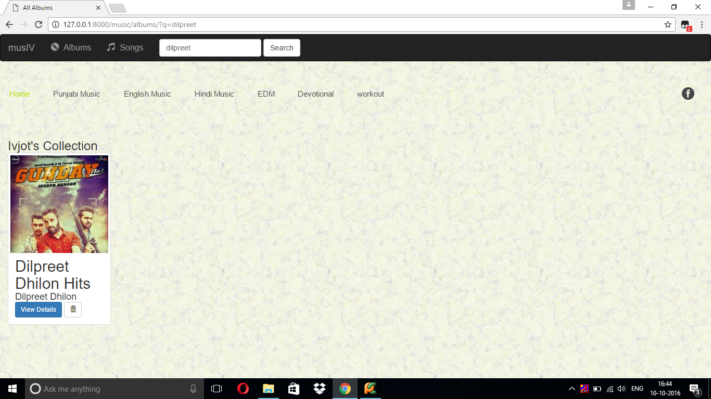

Slide 43
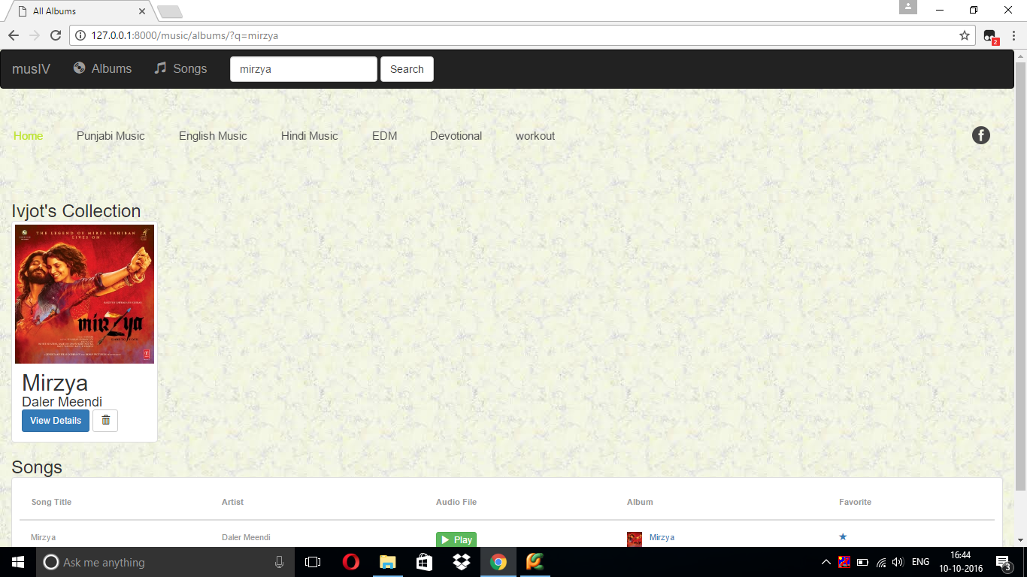

Slide 44
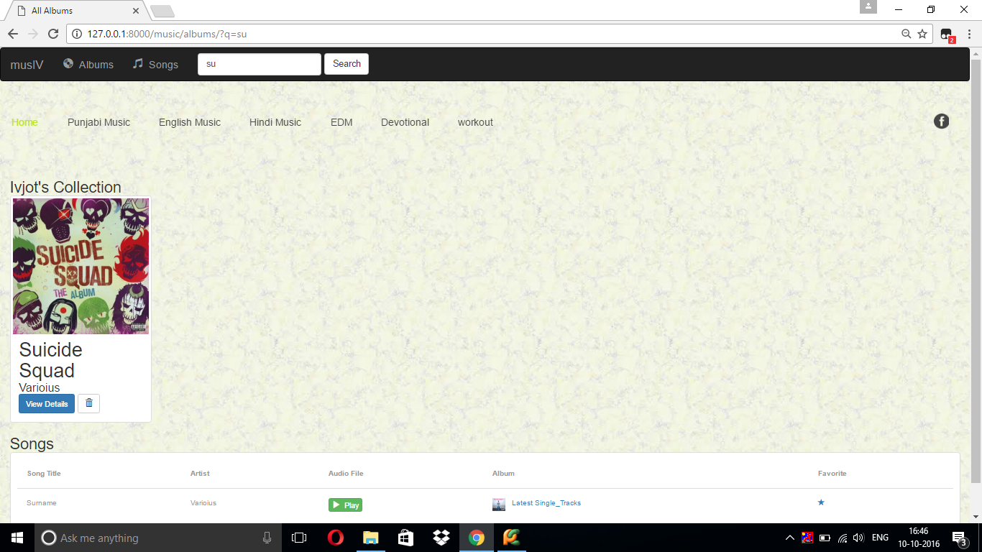

Slide 45
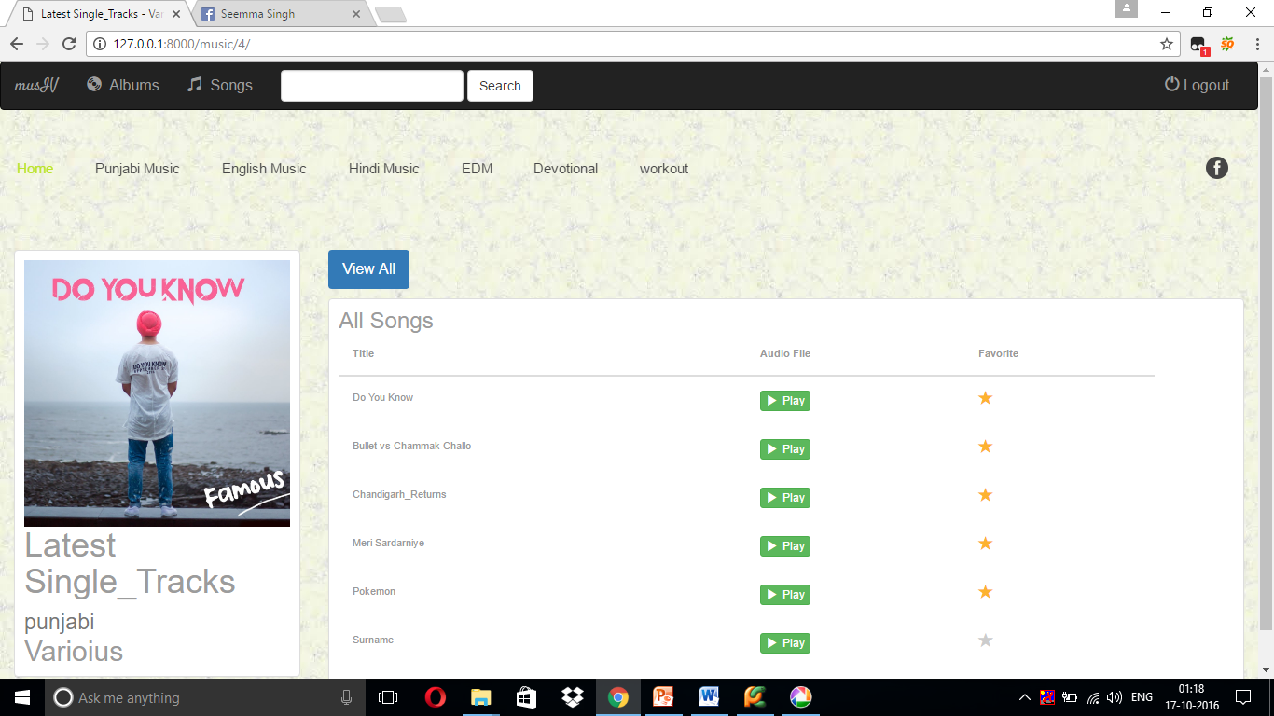

Slide 46
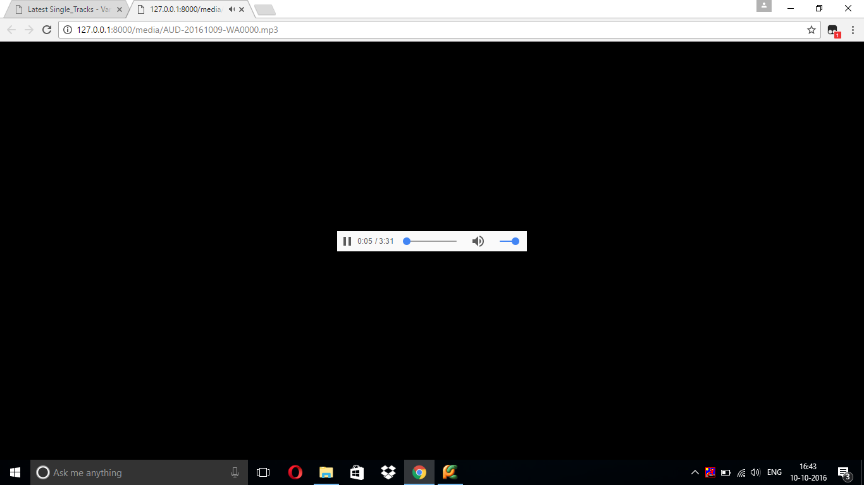


Slide 47
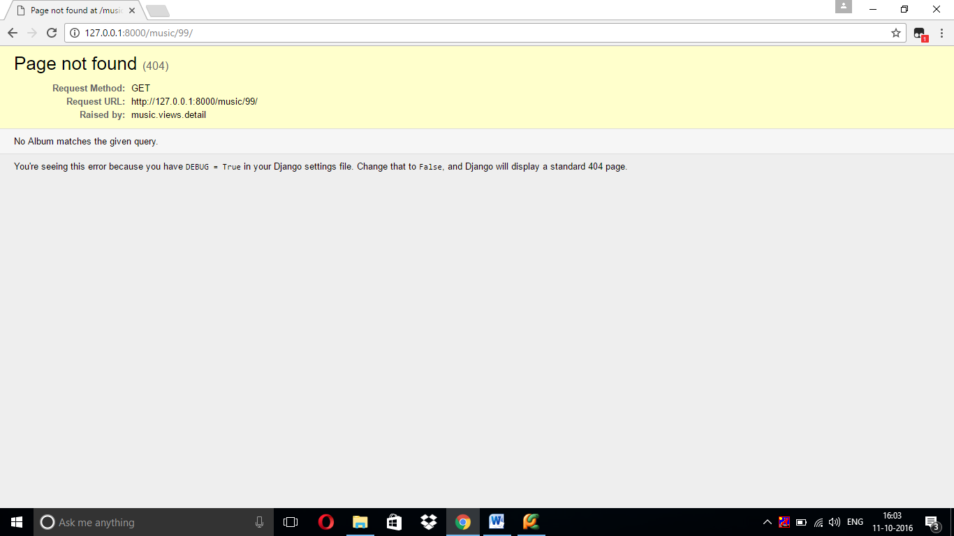
404 errer

Slide 48
musIV
Music By Ivjot
Random shots

Slide 49
Maintenance

Slide 50
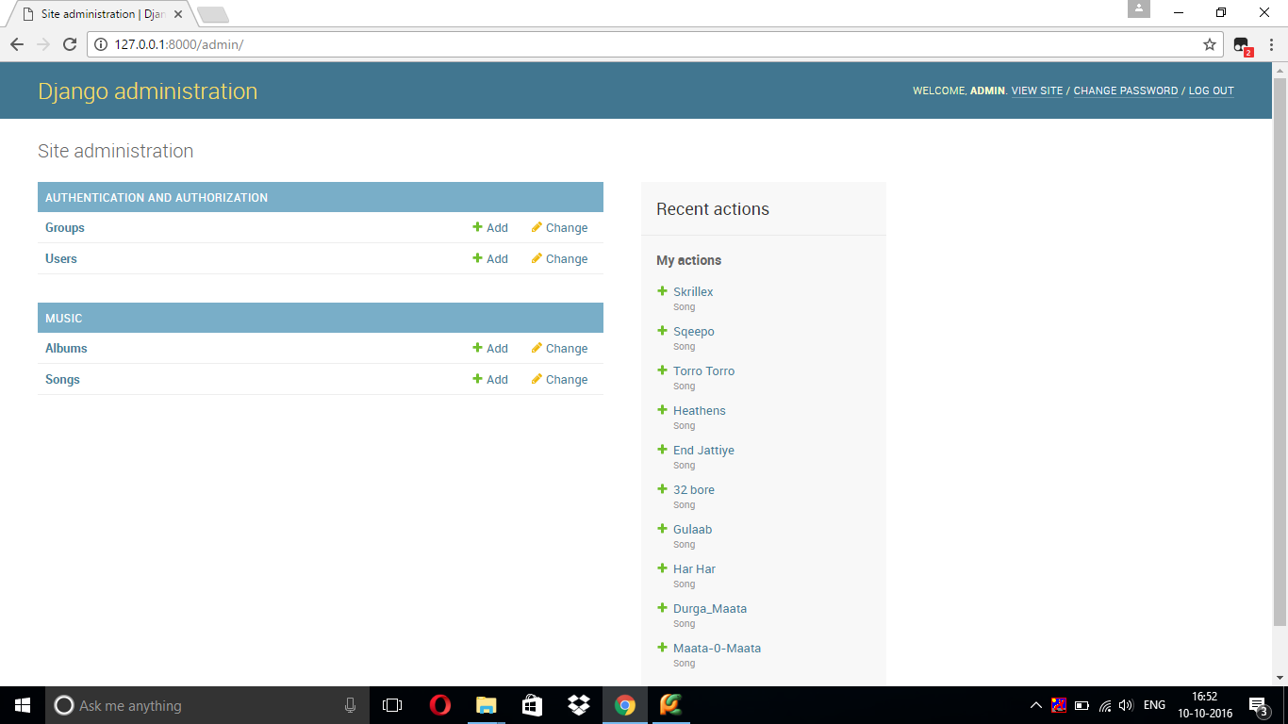
Admin Panel

Slide 51
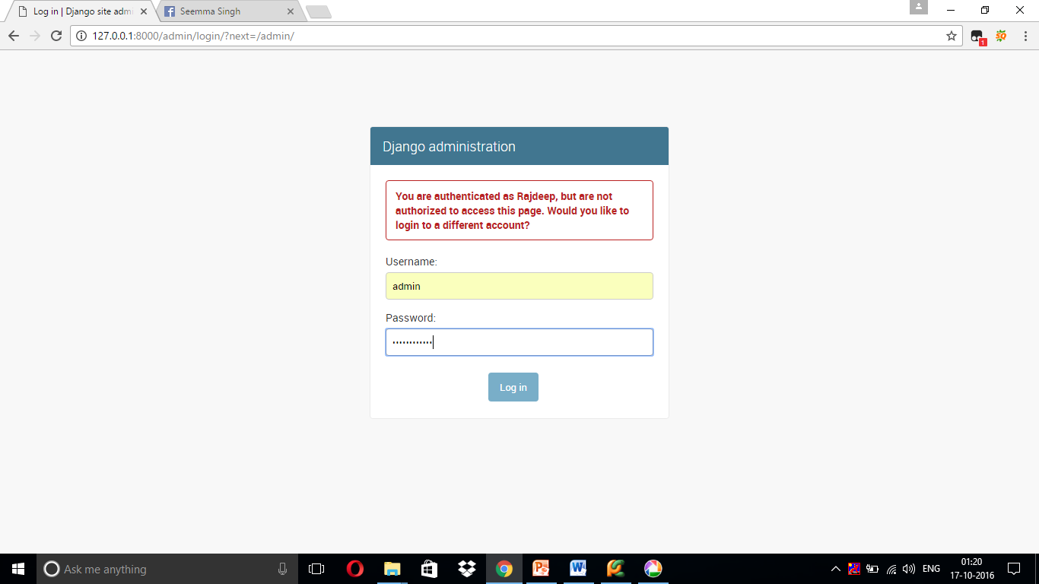

Slide 53
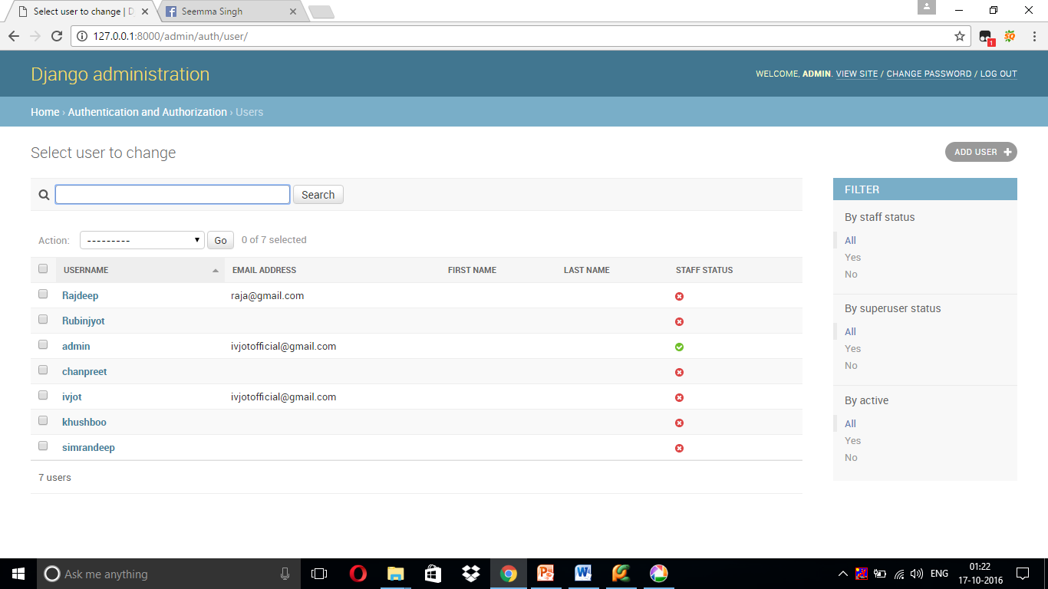

Slide 54
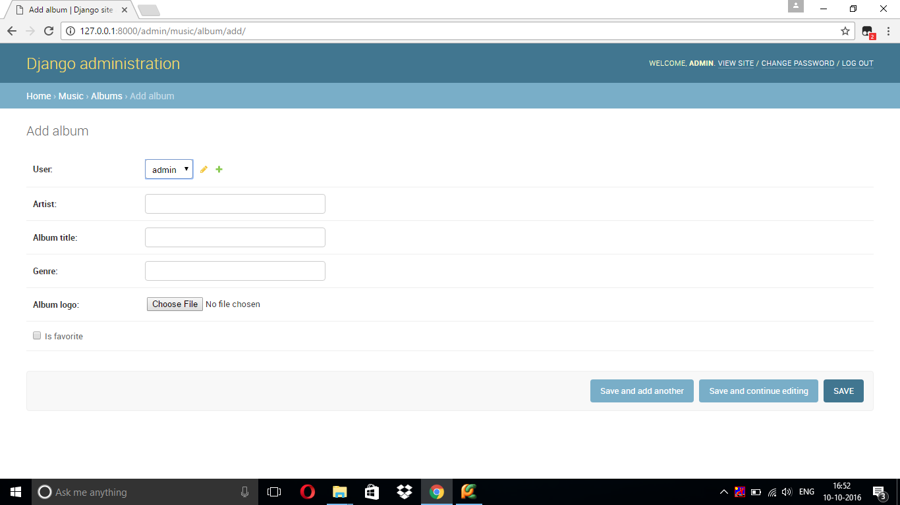

Slide 55
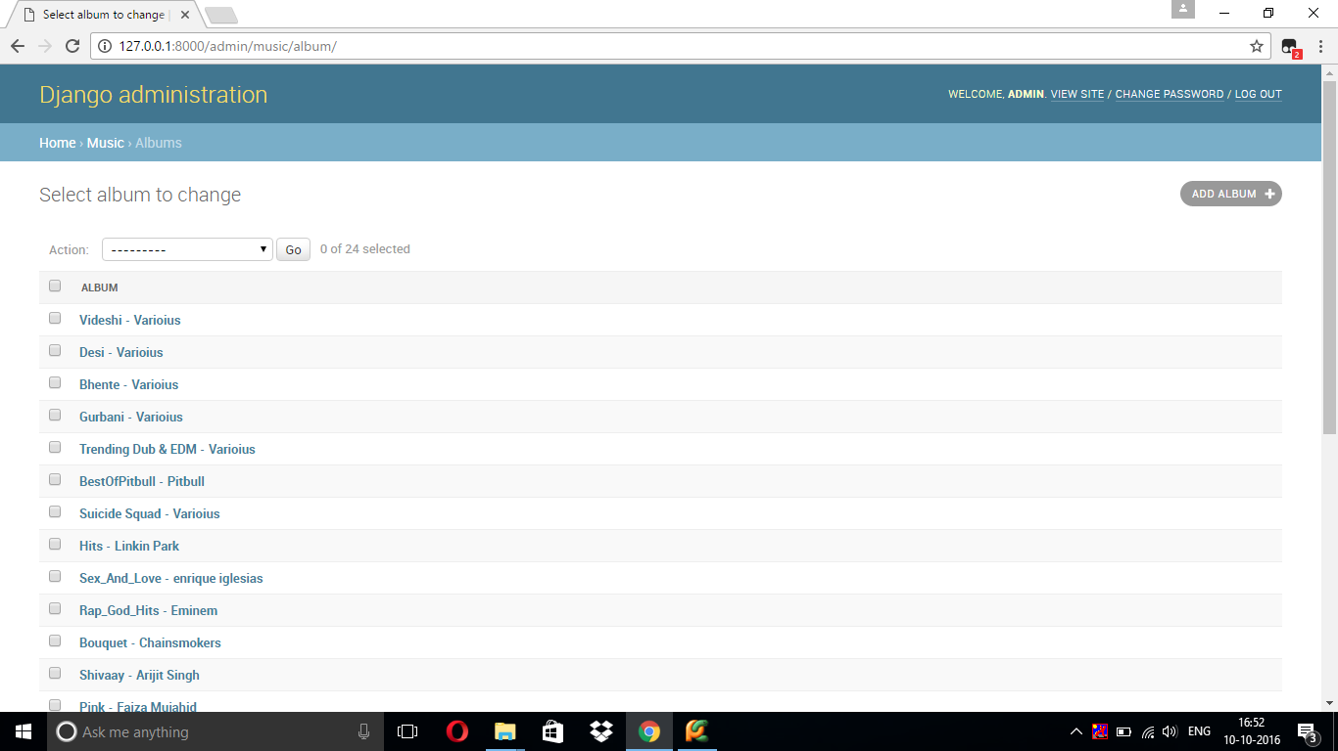

Slide 56
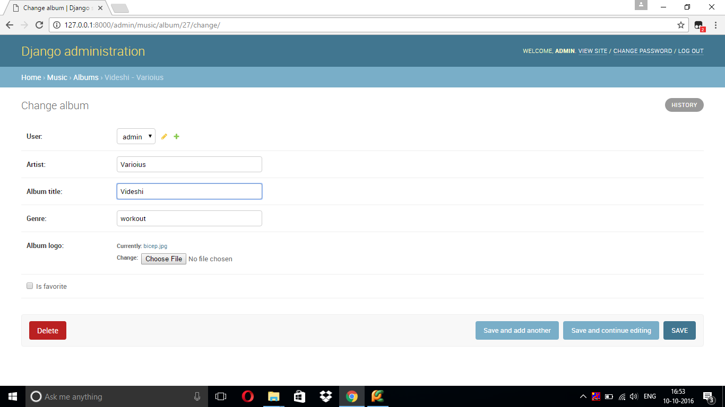

Slide 57


Slide 58
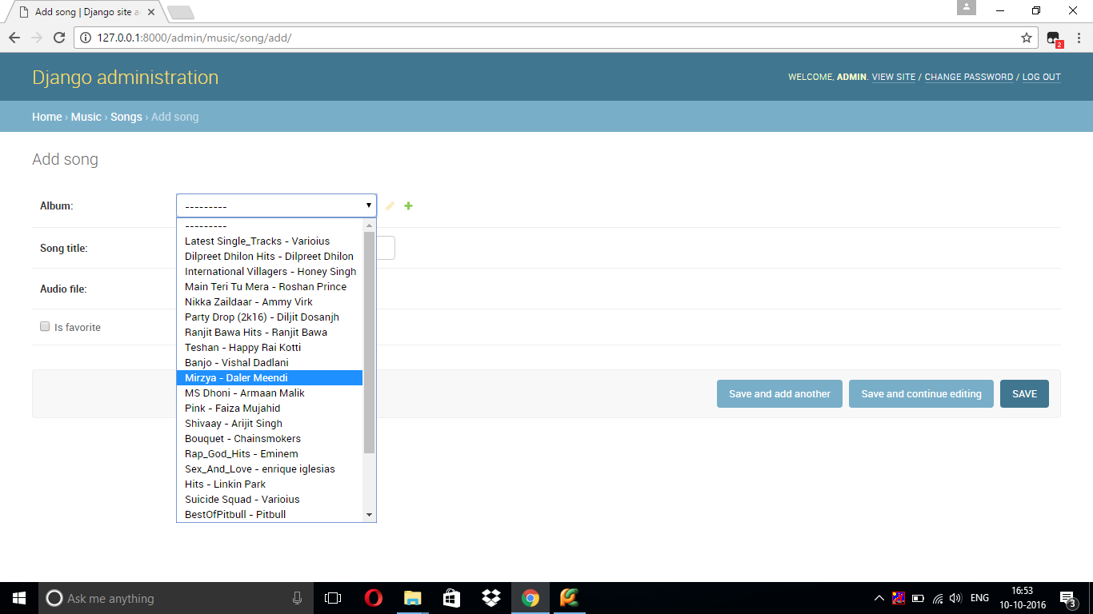

Slide 59
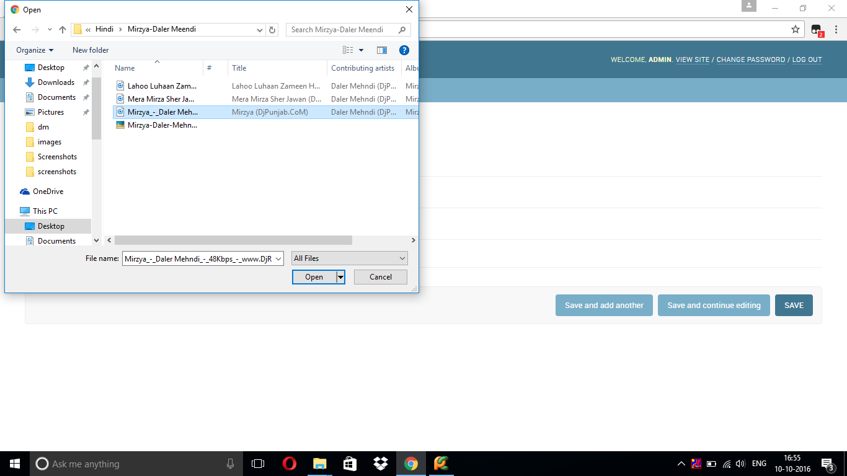

Slide 60
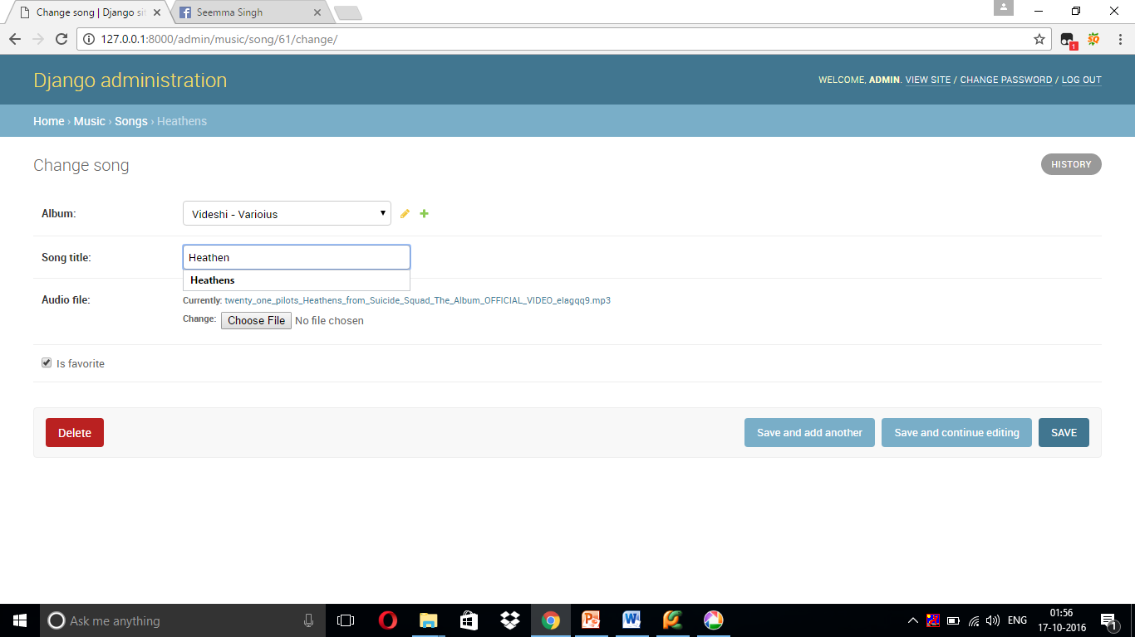

Slide 61
Search Engine Optimization

Slide 62
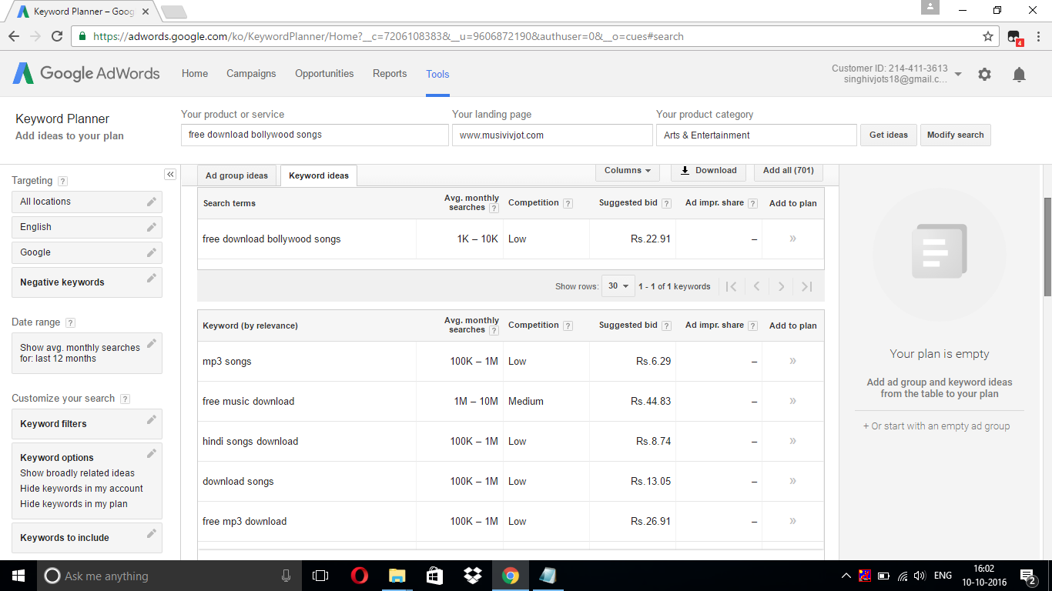
SEO
On page Search Engine Optimization using Digital Marketing Technique and Google Keyword Planner.

Slide 63
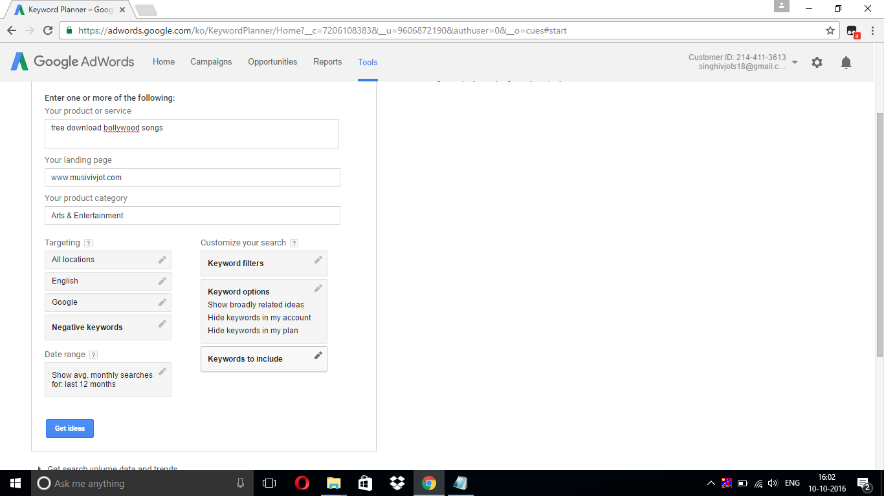

Slide 65
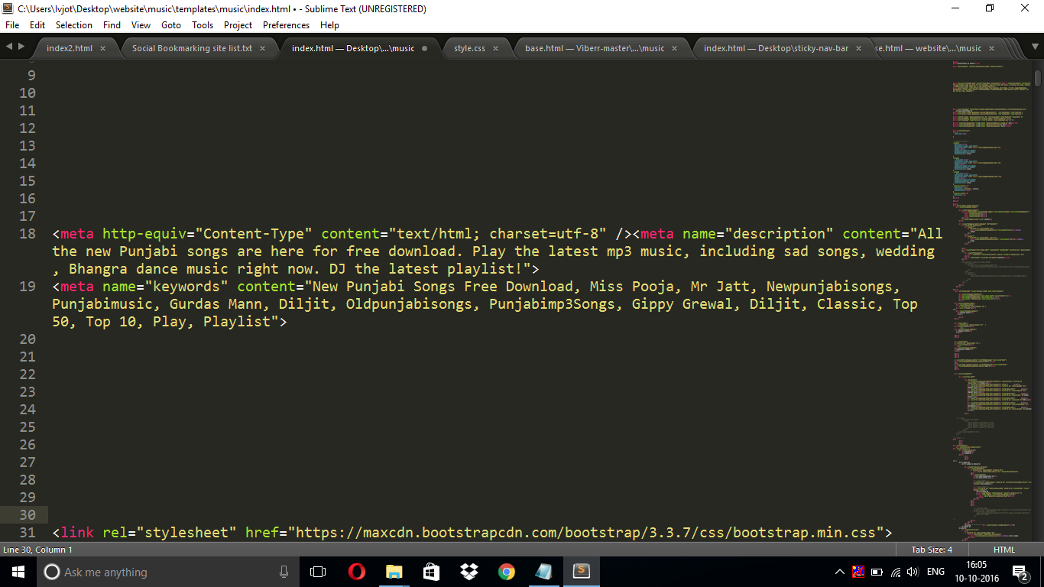

Slide 66
Thank you ☺

